Slide 1
3D Fighting Game
DHD Team
Mai Lê Hùng – ITITIU19125
Nguyễn Hoàng Đạt – ITITIU19097
Lê Tấn Đạt – ITITIU18270
INDEX.HTML

Slide 2
/TABLE OF CONTENTS
/01
Introduce
/02
Technologies
/03
Implement
/04
Result and Future Work
DHD Team
Brief introduction about the game context and how to play
Technologies used in the project
The main steps that make up the project
Current achievements and future improvements
INDEX.HTML

Slide 3
/01
INTRODUCTION
DHD Team
INDEX.HTML

Slide 4
/INTRODUCTION
DHD Team
This is a fighting game set in a dystopia world
Use buttons to move and attack enemies
Players will lose when they run out of health and win when they destroy all enemies
INDEX.HTML

Slide 5
/02
TECHNOLOGIES
DHD Team
INDEX.HTML

Slide 6


/TEACHNOLOGIES
DHD Team
/Unity
/C#
A cross-platform game engine
First announced and released in June 2005
Extended to support a variety of platform
-A script must be attached to a GameObject in the scene in order to be called by Unity.
-The language that’s used in Unity is called C#
-Object-oriented scripting languages
INDEX.HTML

Slide 7
/03
IMPLEMENT
DHD Team
INDEX.HTML

Slide 8
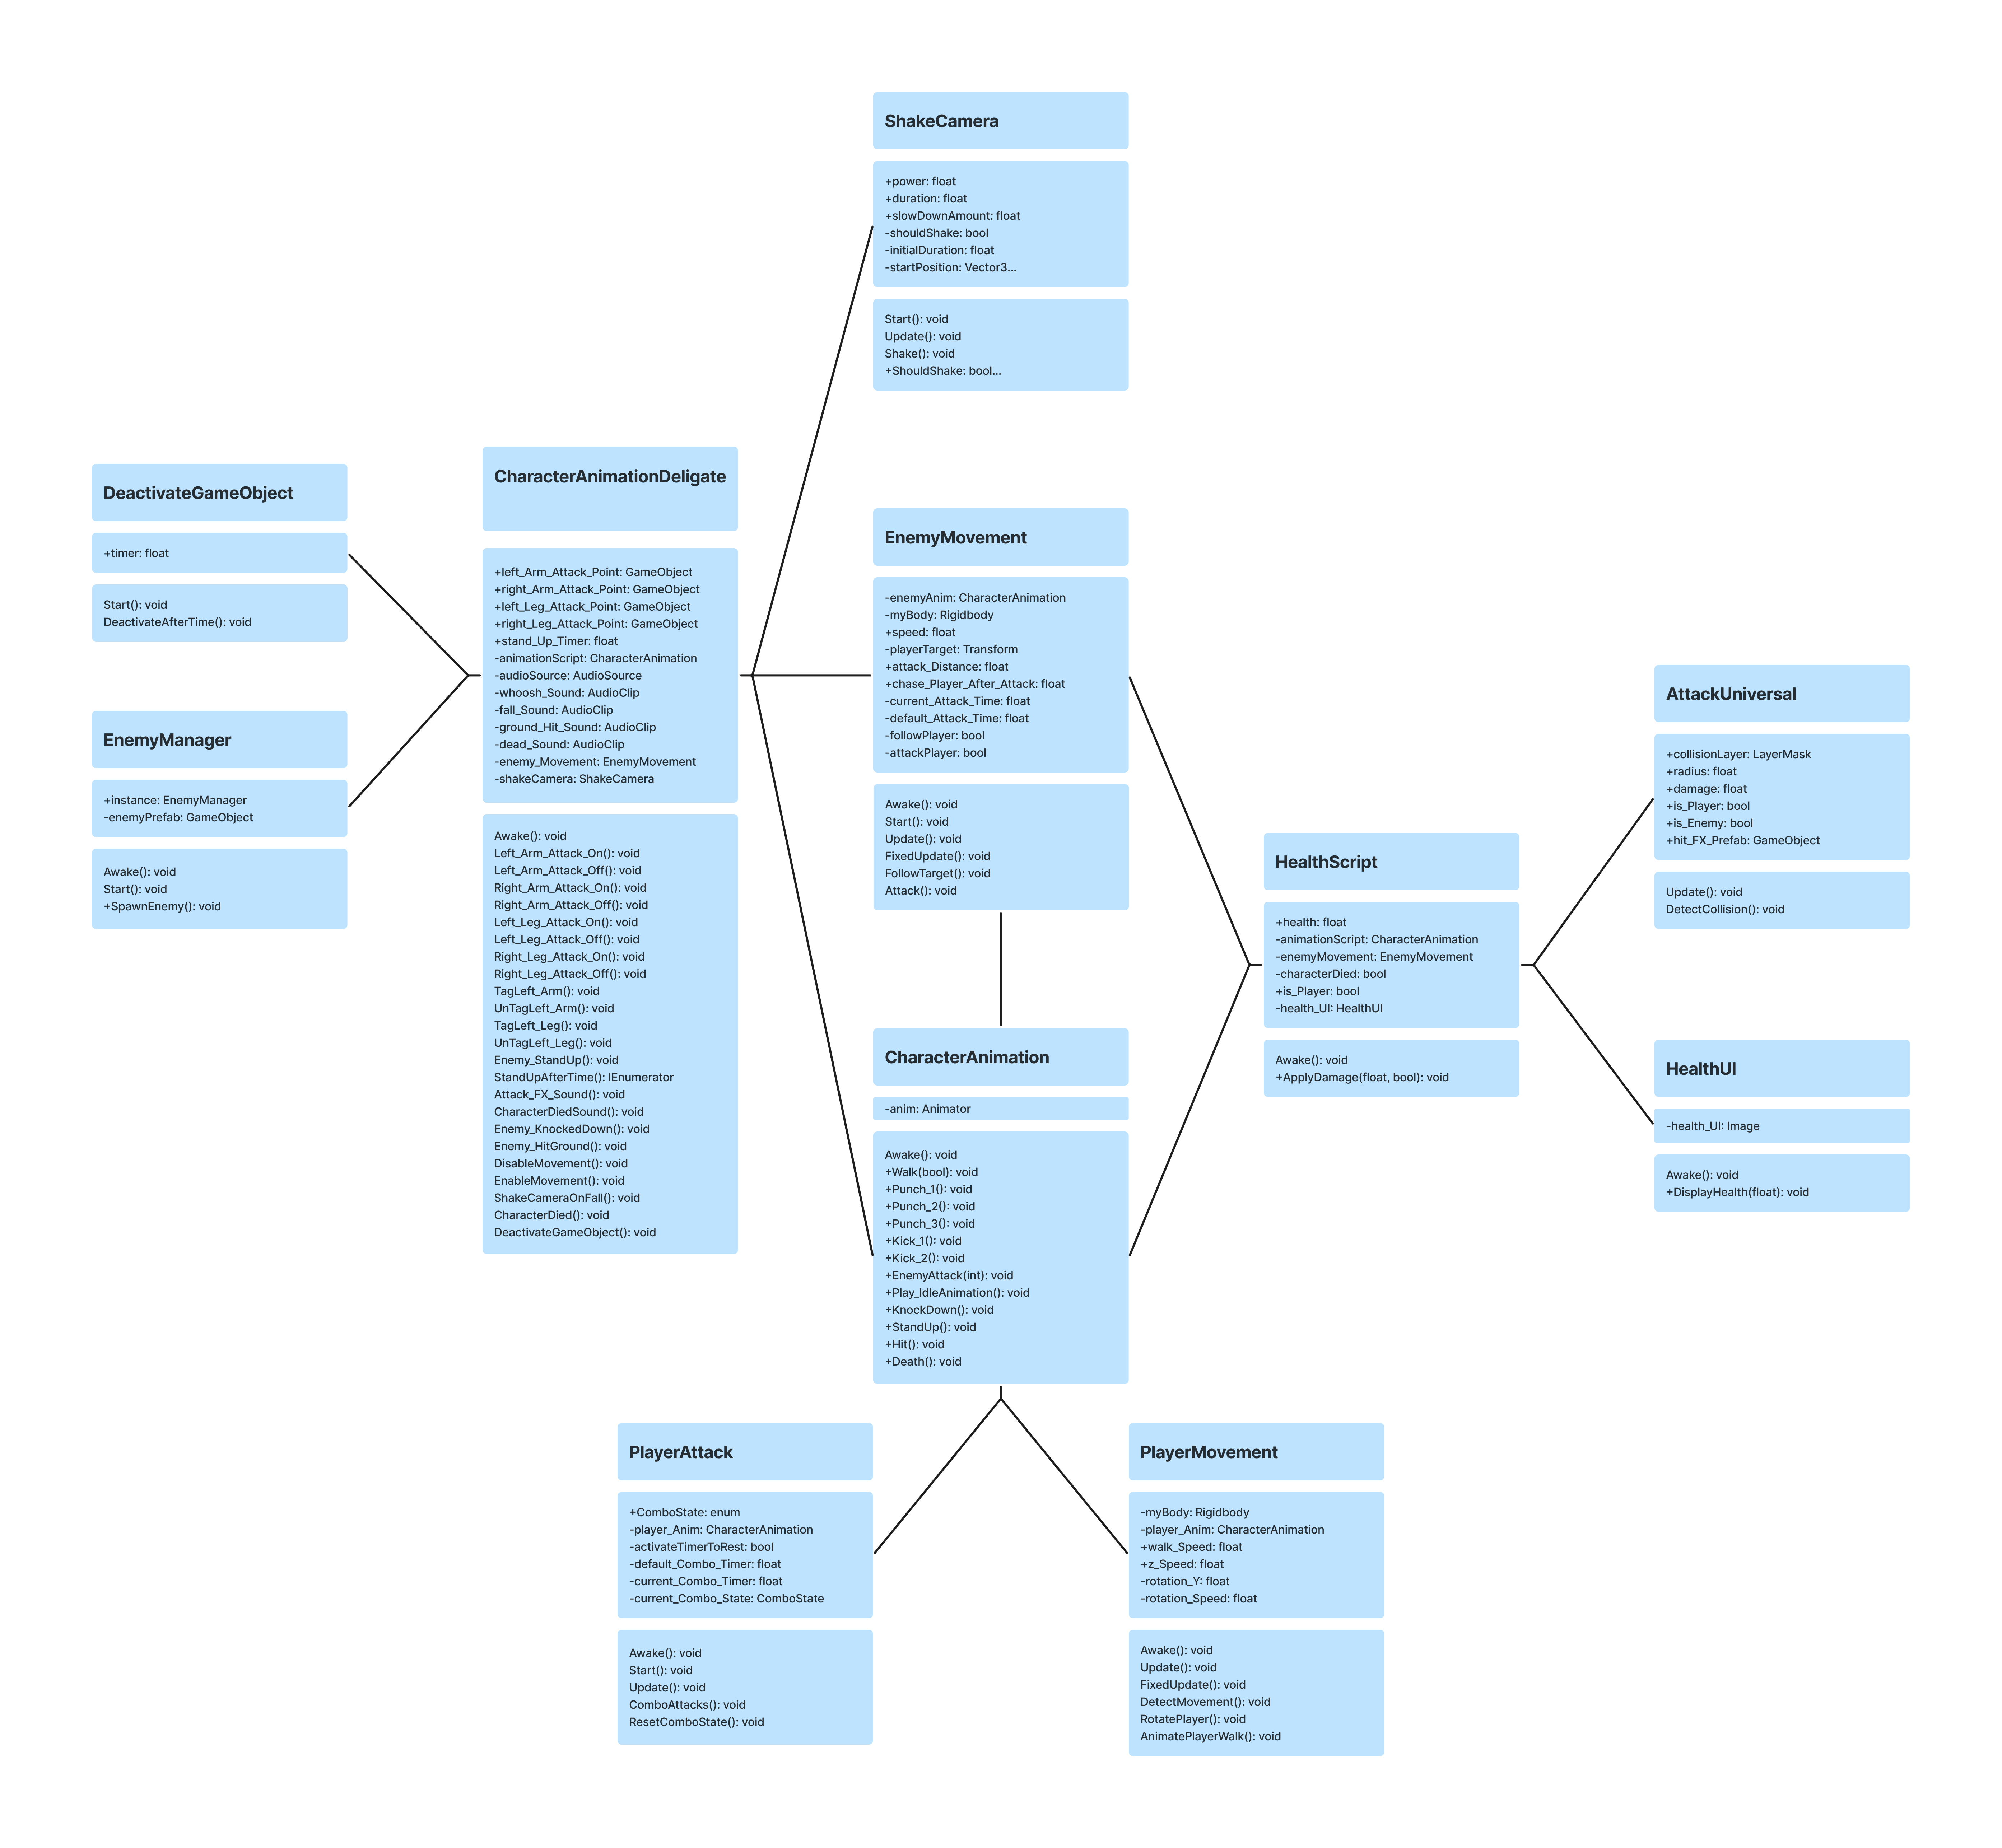
/CLASS DIAGRAM
DHD Team
INDEX.HTML

Slide 9
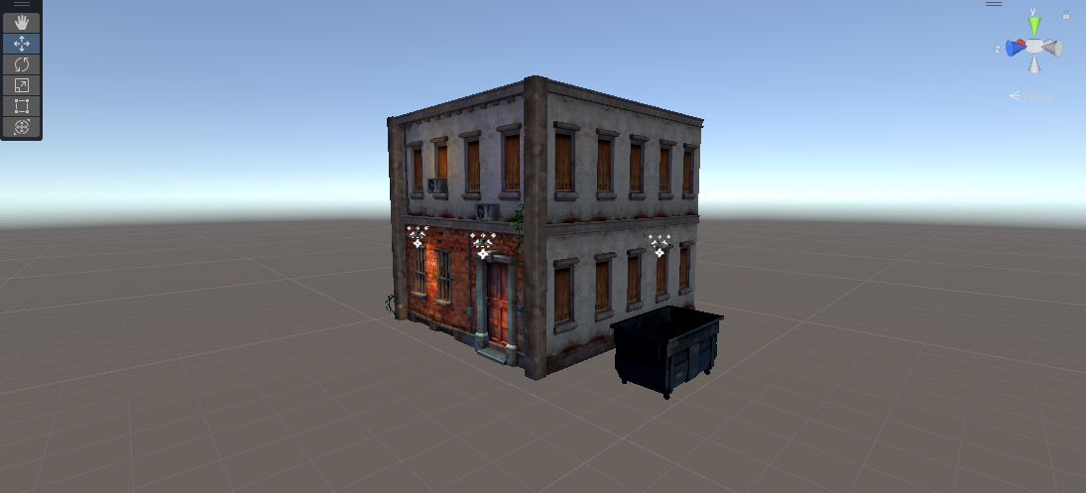
/MAKING ENVIROMENT
DHD Team
INDEX.HTML

Slide 10
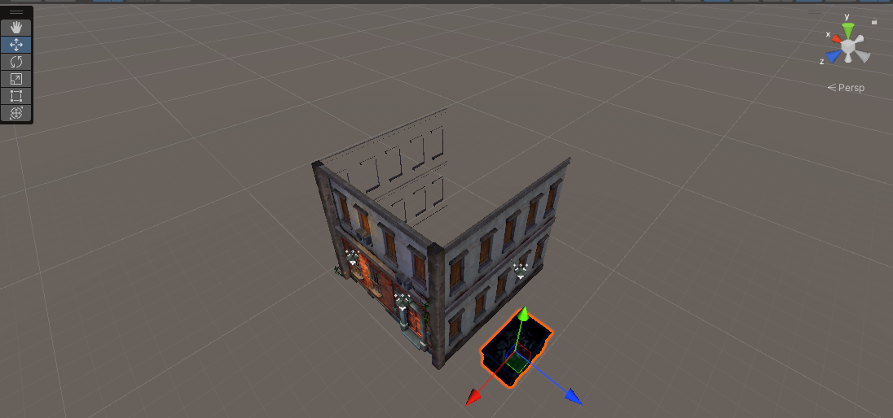
/MAKING ENVIROMENT
DHD Team
INDEX.HTML

Slide 11
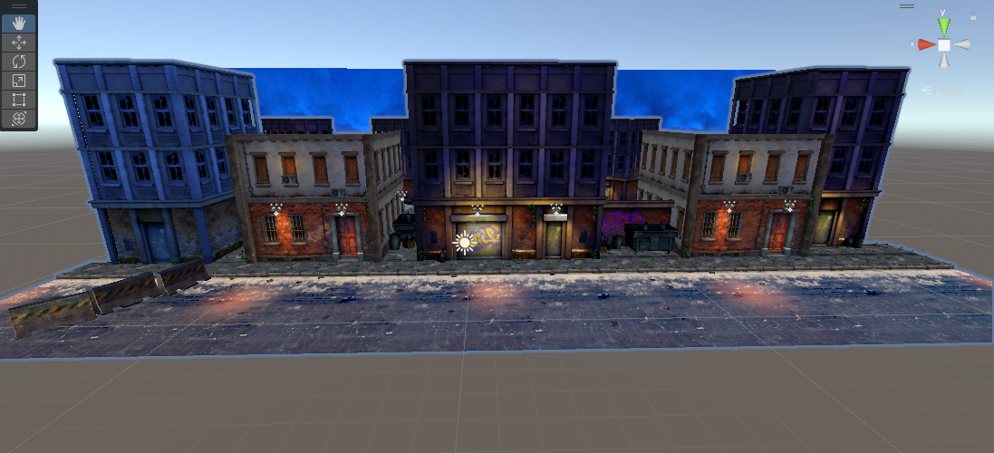
/MAKING ENVIROMENT
DHD Team
INDEX.HTML

Slide 12
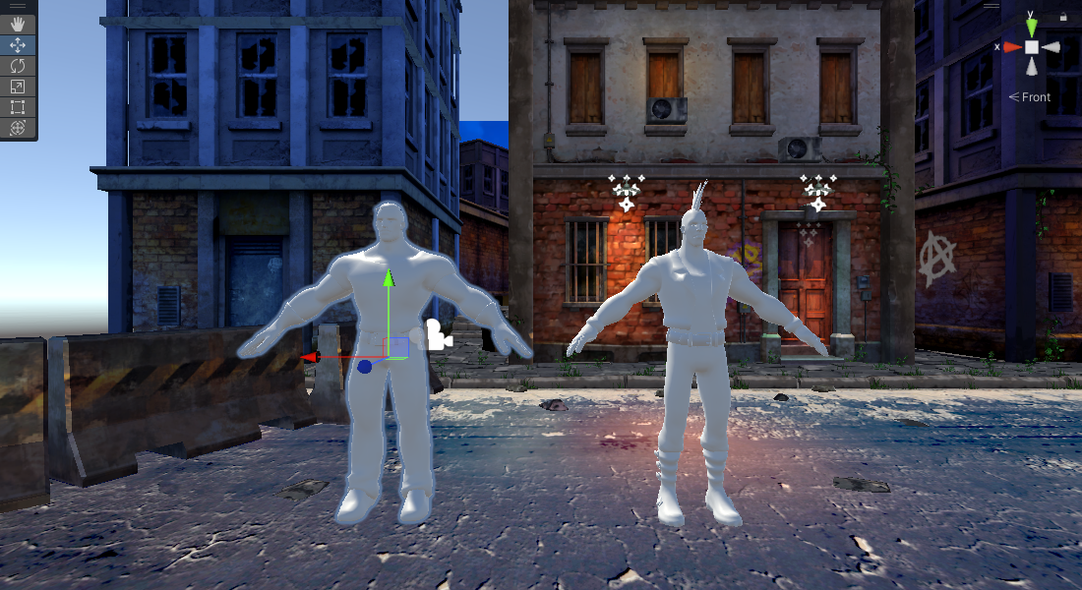
/MAKING CHARACTER MODELS
DHD Team
INDEX.HTML

Slide 13
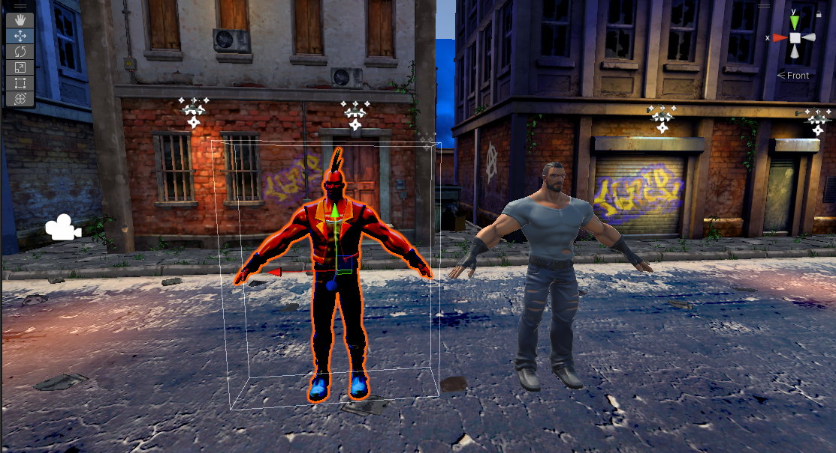
/MAKING CHARACTER MODELS
DHD Team
INDEX.HTML

Slide 14
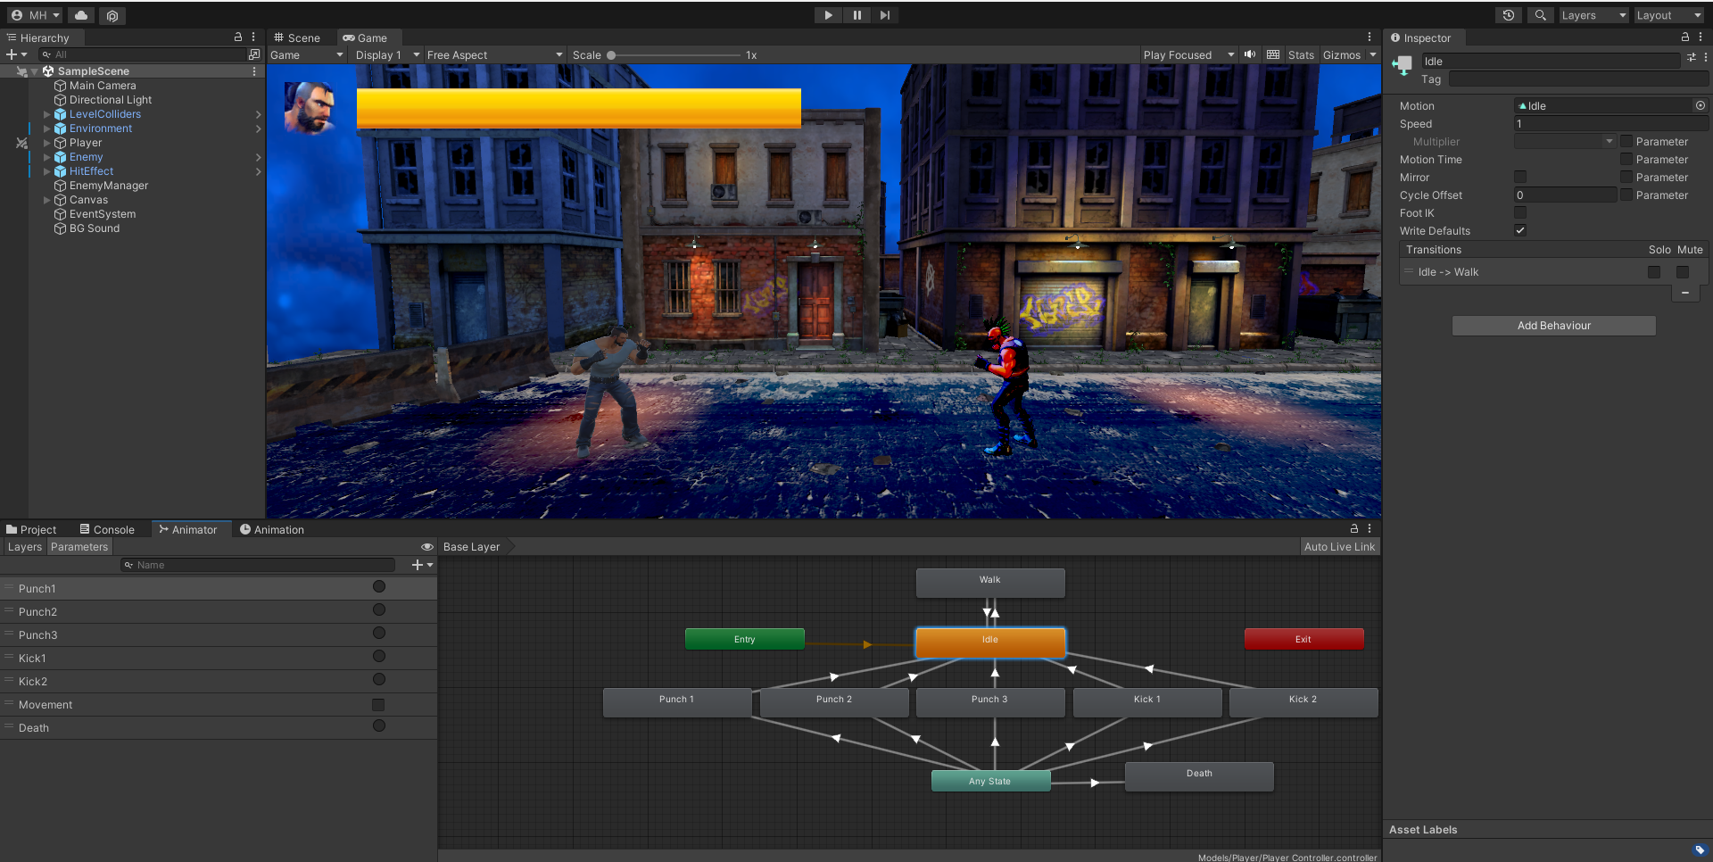
/MOVEMENTS AND ANIMATIONS
DHD Team
INDEX.HTML

Slide 15
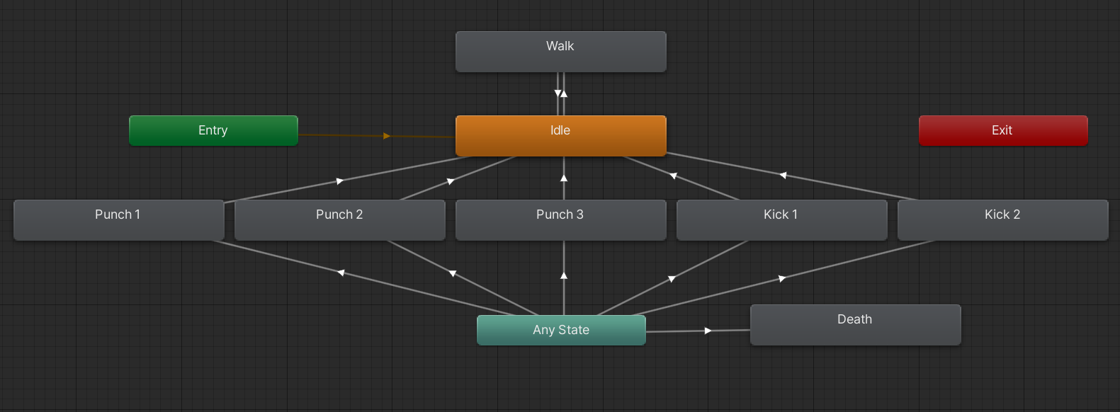
/MOVEMENTS AND ANIMATIONS
DHD Team
INDEX.HTML

Slide 16
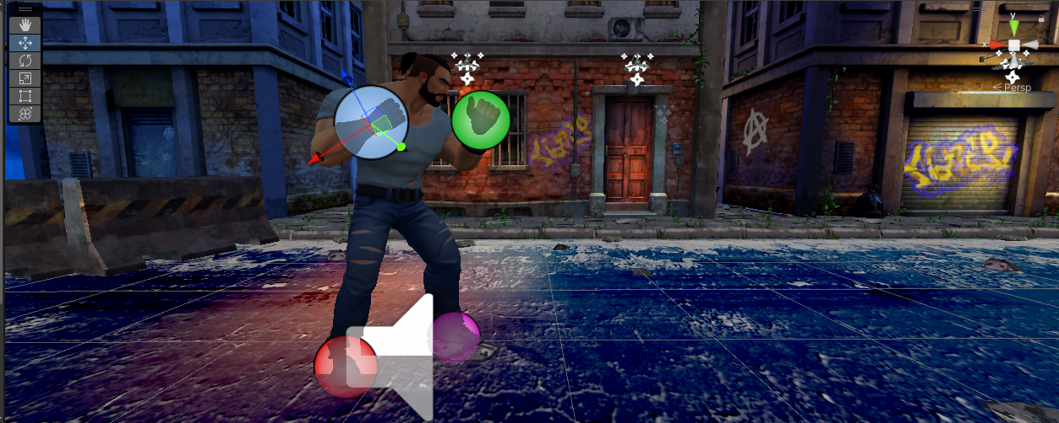
/HIT BOX
YOUR LOGO HERE
INDEX.HTML

Slide 17
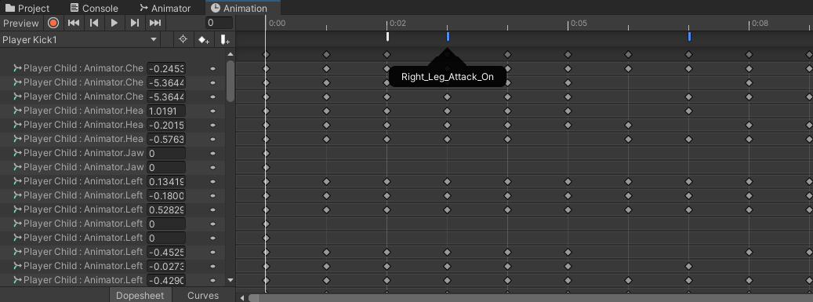
/HIT BOX
DHD Team
INDEX.HTML

Slide 18
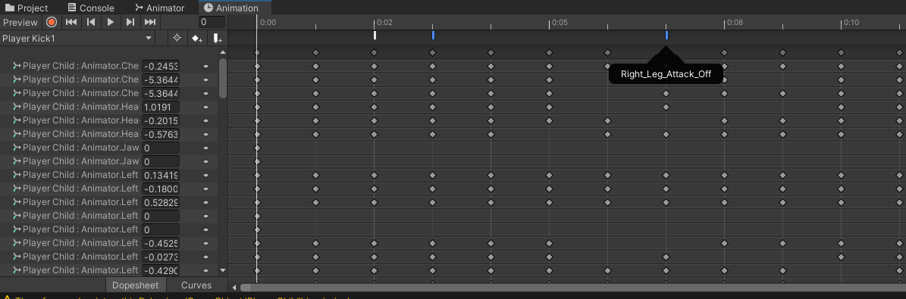
/HIT BOX
DHD Team
INDEX.HTML

Slide 19
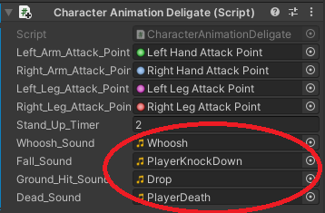
/SOUND
DHD Team
INDEX.HTML

Slide 20
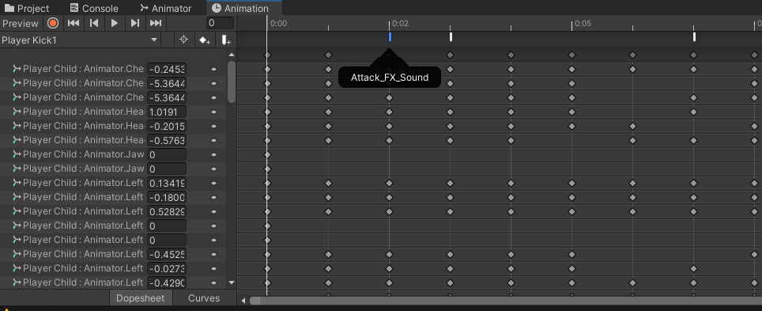
/SOUND
YOUR LOGO HERE
INDEX.HTML

Slide 21
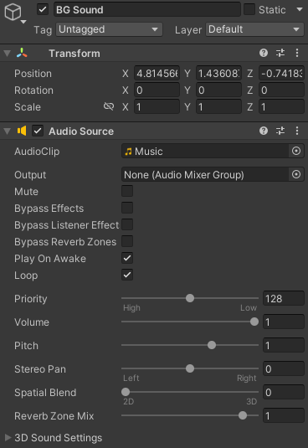
/SOUND
DHD Team
INDEX.HTML

Slide 22
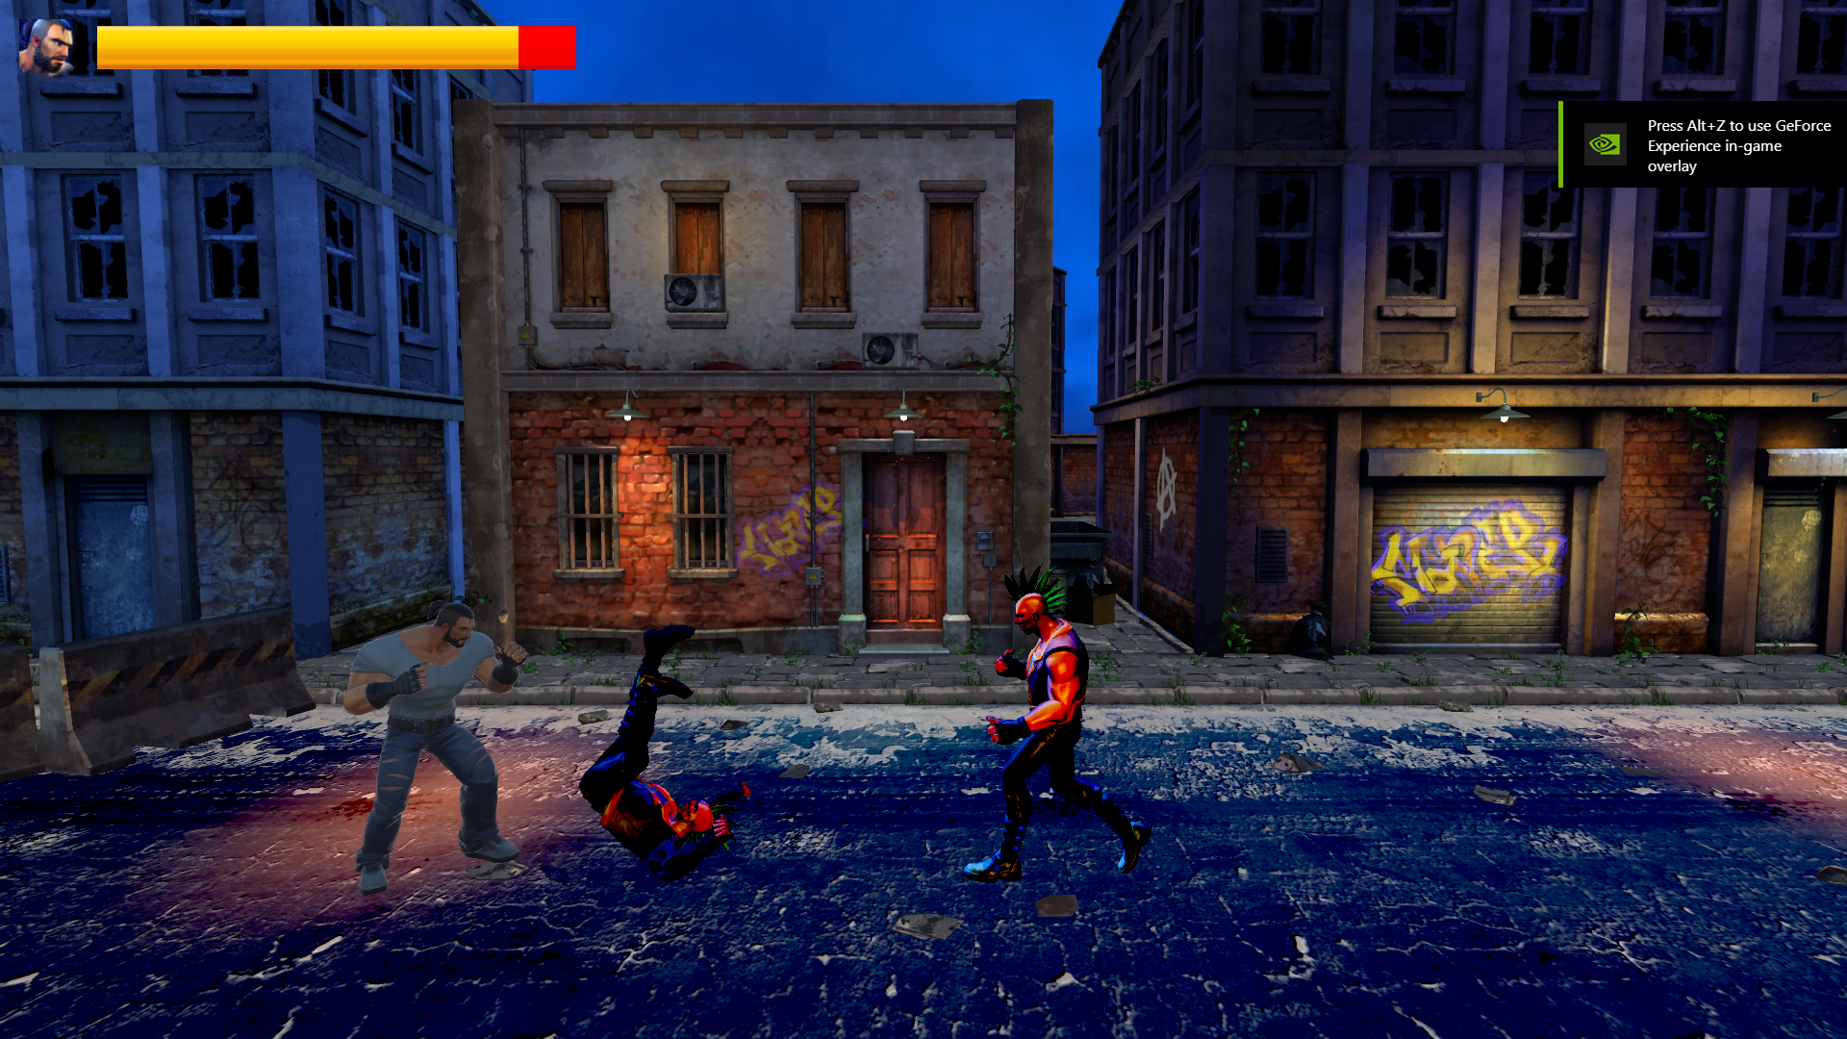
/CAMERA SHAKE
DHD Team
INDEX.HTML

Slide 23
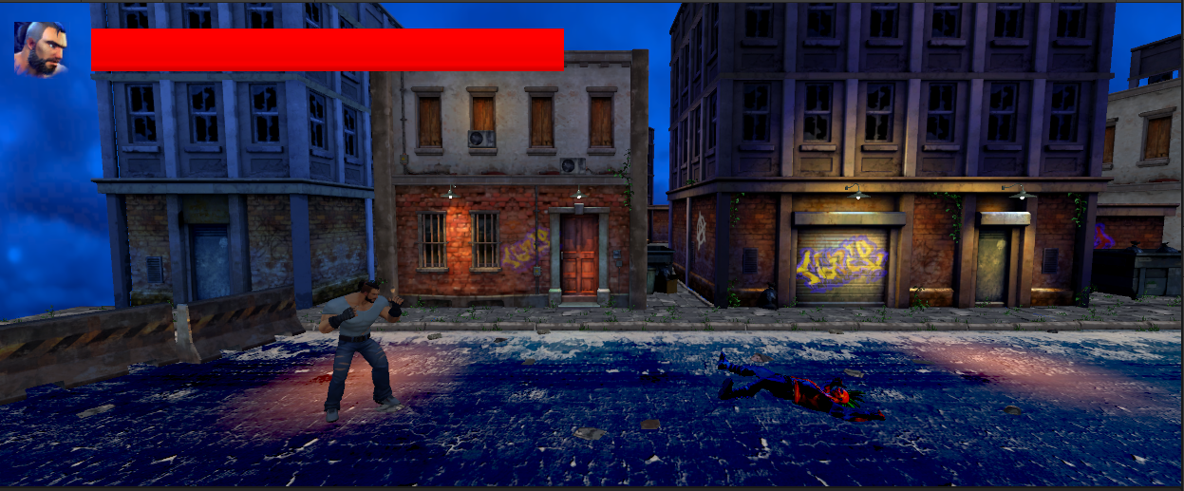
/HEALTH BAR
DHD Team
INDEX.HTML

Slide 24
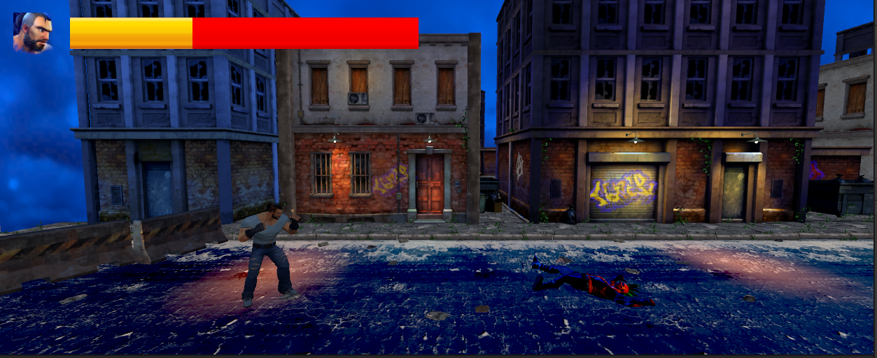
/HEALTH BAR
DHD Team
INDEX.HTML

Slide 25
/04
Result and Future Work
DHD Team
INDEX.HTML

Slide 26
/THANKS!
DHD Team
/DO YOU HAVE ANY QUESTIONS?
My email: mungle.hai@gmail.com
INDEX.HTML

